Slide 1
Neural Networks I Basics

Slide 2
The basis of thought processes
Presumably, all (thought) processes in our brain are based on the activation of neurons that are interconnected to form networks.
But these neurons aren't just wired together in a disorderly fashion, they're structured in different ways depending on the brain region.

Slide 3
Artificial Neural Networks
Artificial neural networks try to replicate
the properties of neurons
the structure of their arrangement (topology)
learning processes
What is a neural network?
What is a neuron?
What is the difference to a conventional computer (von Neumann architecture)?
We do not want to go into details about the learning process (backpropagation).

Slide 4
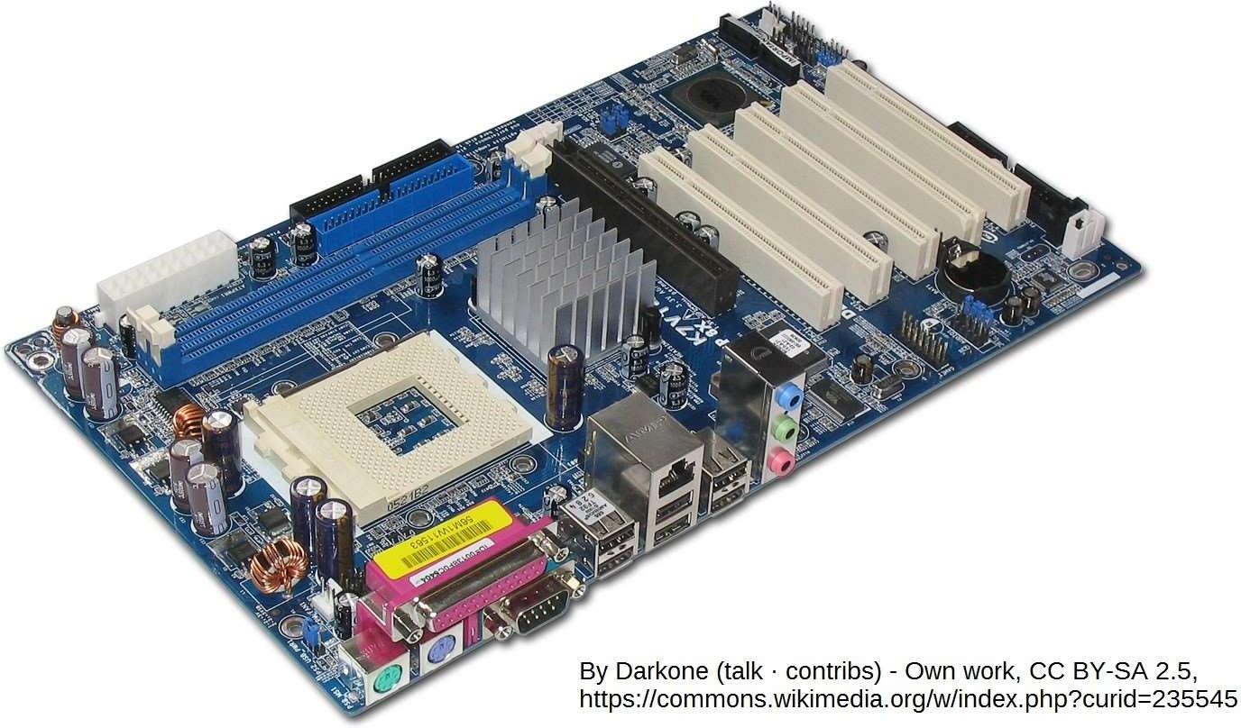
Neural Networks vs Conventional Computers
In contrast to a conventional computer (picture above), there is no central processing unit in the brain but a large number of small processing units that work together to achieve thought processes. The individual small computing units only perform relatively small tasks, but many of them work in parallel.

Slide 5
Feed-Forward-Netzwerk
In our first example we will see how an artificial neural network solves a graphical task. There are separate network types for this, but we will use a simple socalled feed-forward network. This also works, but a more suitable network type would increase the recognition accuracy.

Slide 6
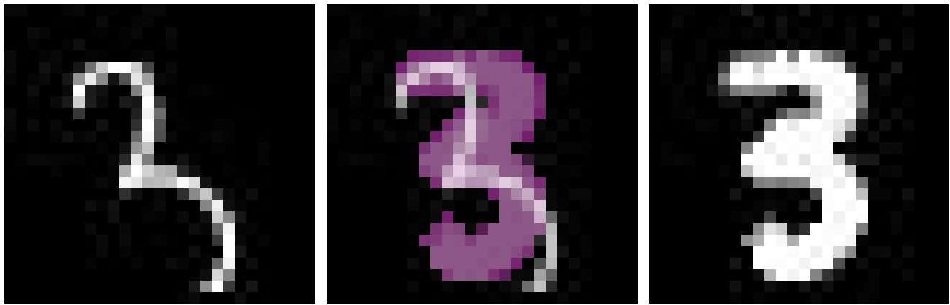
Digit and character recognition with a neural network
Digit and character recognition is a demanding task. The task is difficult to solve with conventional programming methods.
All spellings for "3" should be recognized, at first glance different spellings may not have much in common.

Slide 7
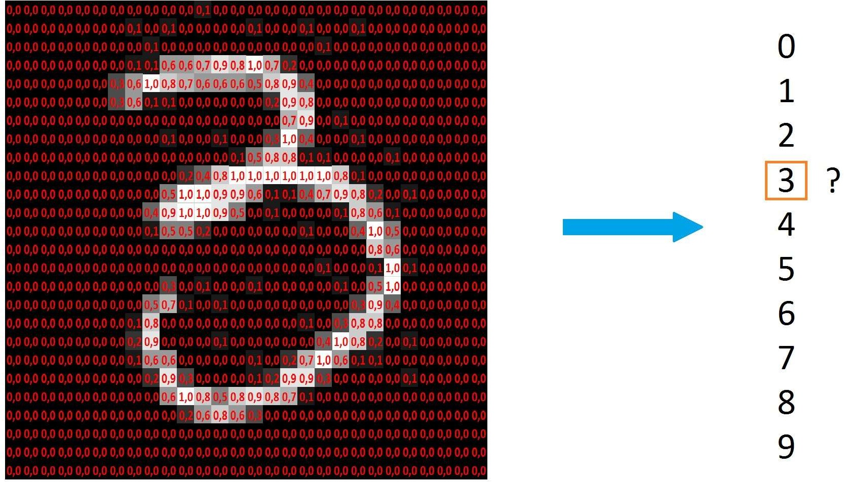
Activation
We proceed in such a way that we interpret the individual pixel brightnesses as activation variables and ask which activation pattern should be recognized as which number.

Slide 8
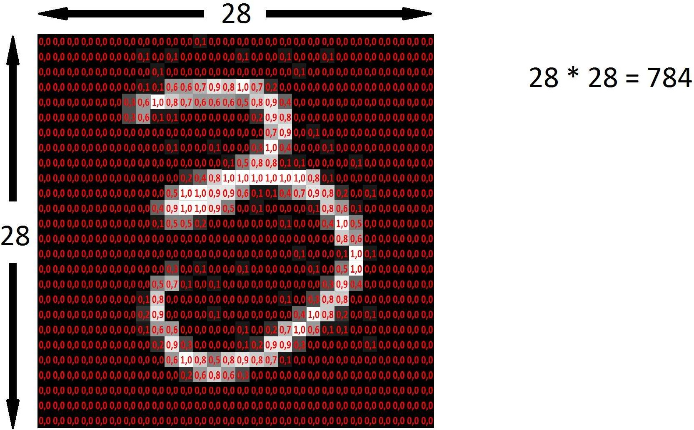
784 Pixels
The size of our images is 28 x 28 = 784 pixels.

Slide 9
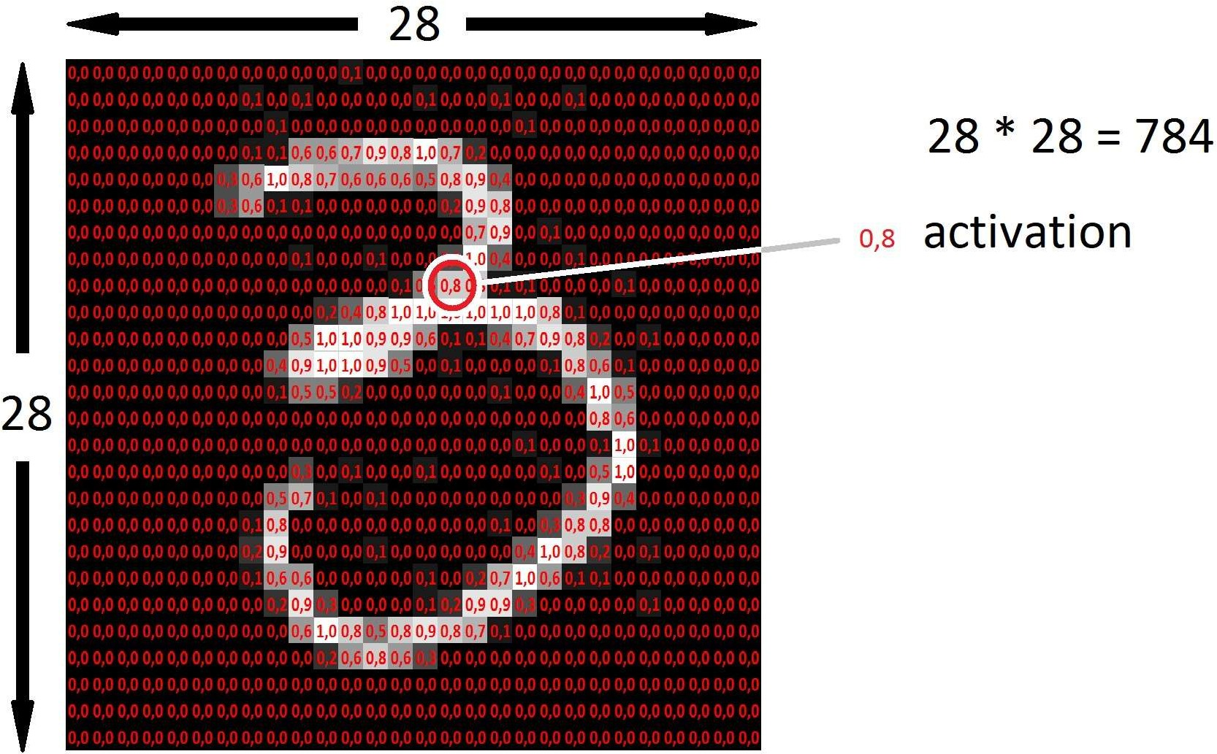
Activation
As activation we use a value between 0 and 1.

Slide 10
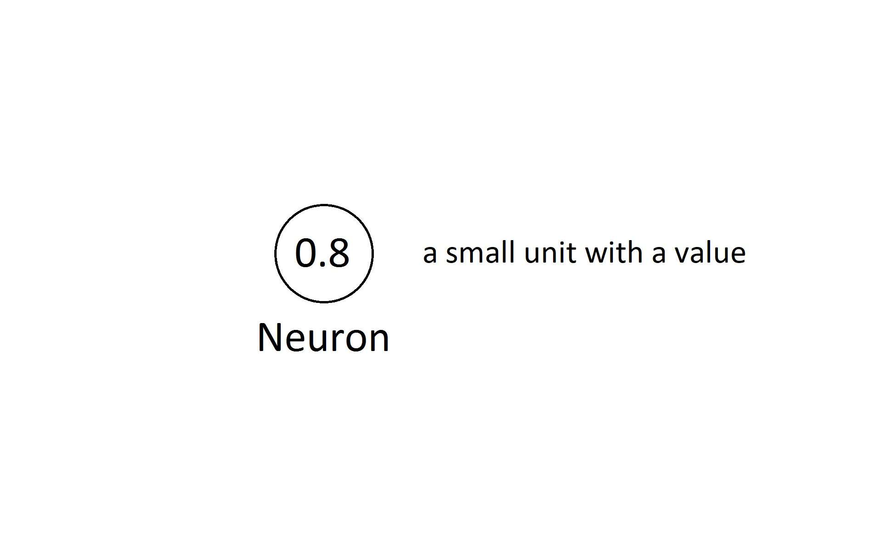
Neuron
A neuron is a small unit with a value.

Slide 11
Network Structure
In the input layer, the inputs are made available as activations.
Within the network, the values represent activation states of the individual neurons.
The number of input neurons results from the number of pixels.
Spatial information is lost.
The number of neurons in the second and third layer can be chosen freely and was chosen at 16 quite arbitrarily.
The number of output neurons corresponds to the number of possible outcomes.

Slide 12
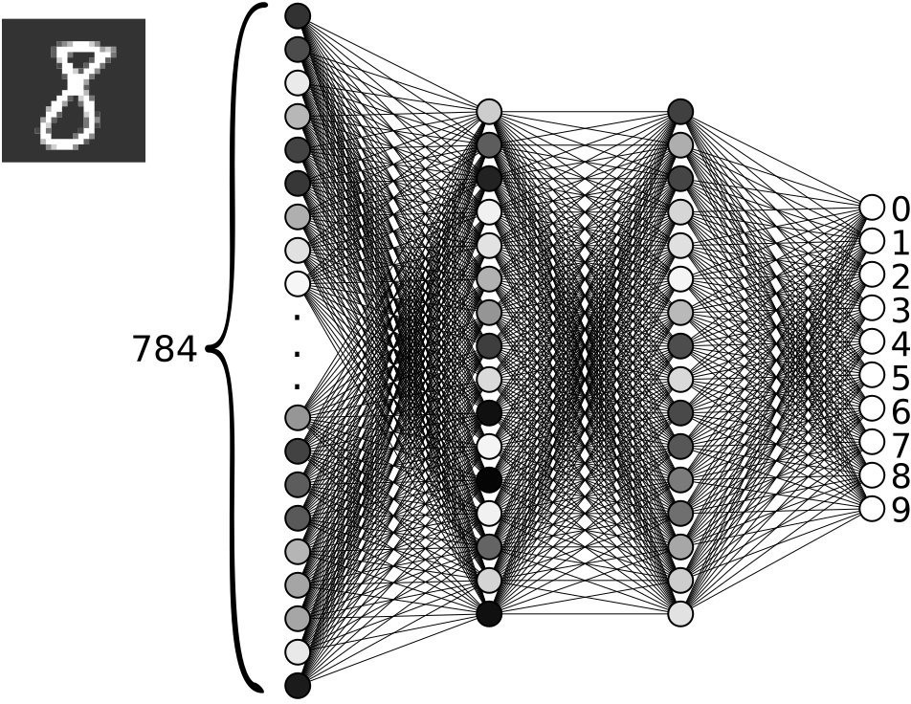
Layers

Slide 13
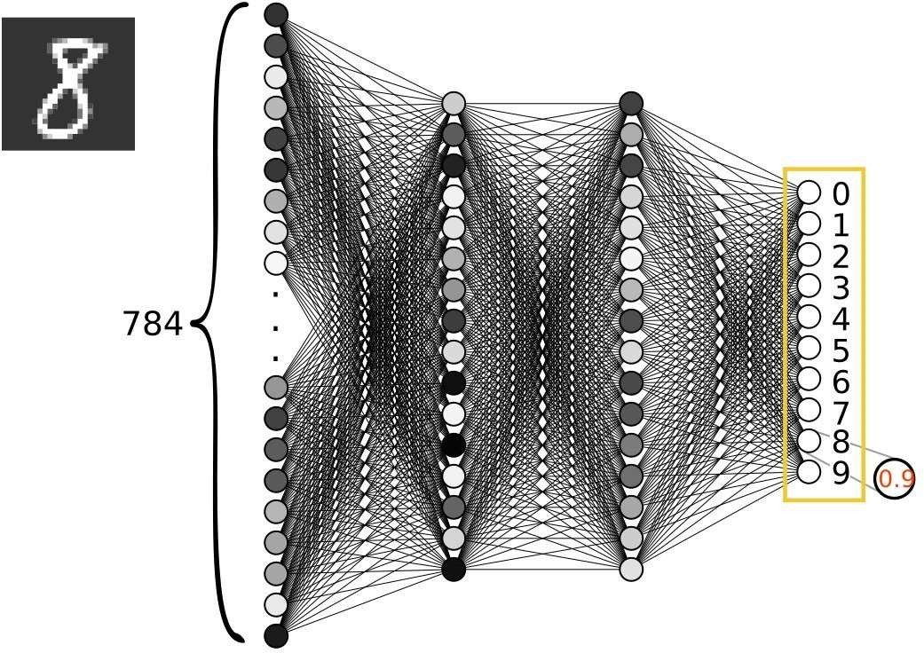
Output Layer
Result values are provided as activations in the output layer.

Slide 14
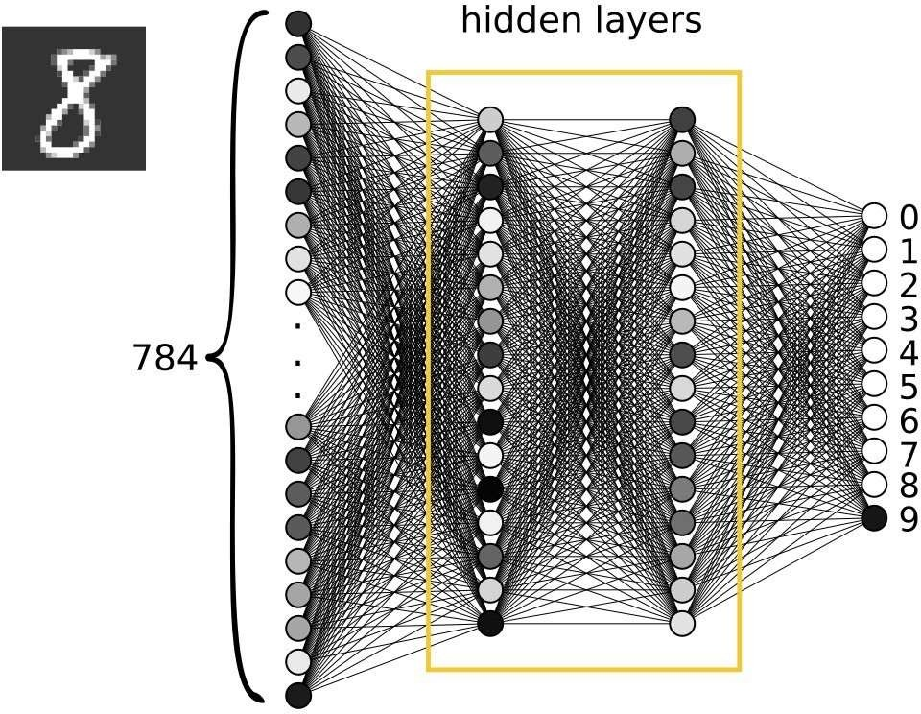
Hidden Layers
The layers between the input and output layers are called hidden layers.

Slide 15
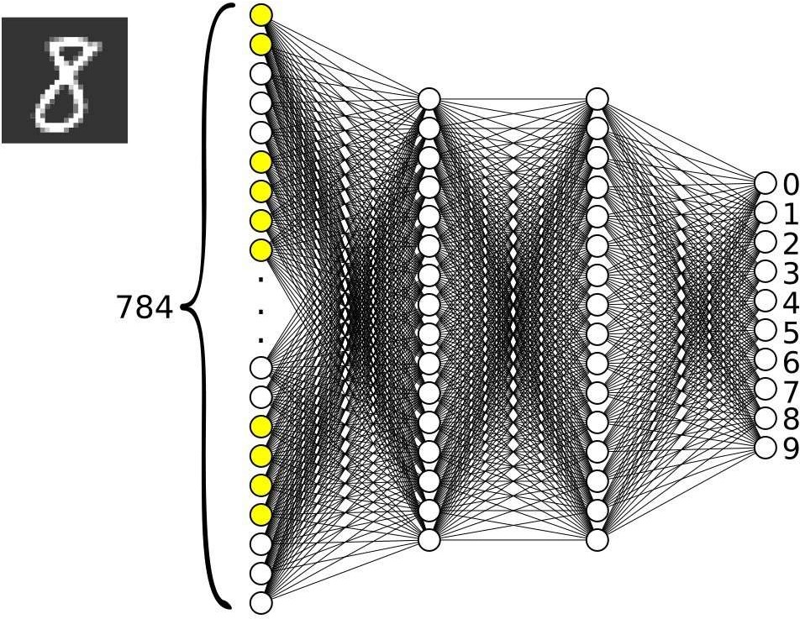
Flow of Data through the Network
The activations of one layer become the inputs of the next layer.

Slide 16
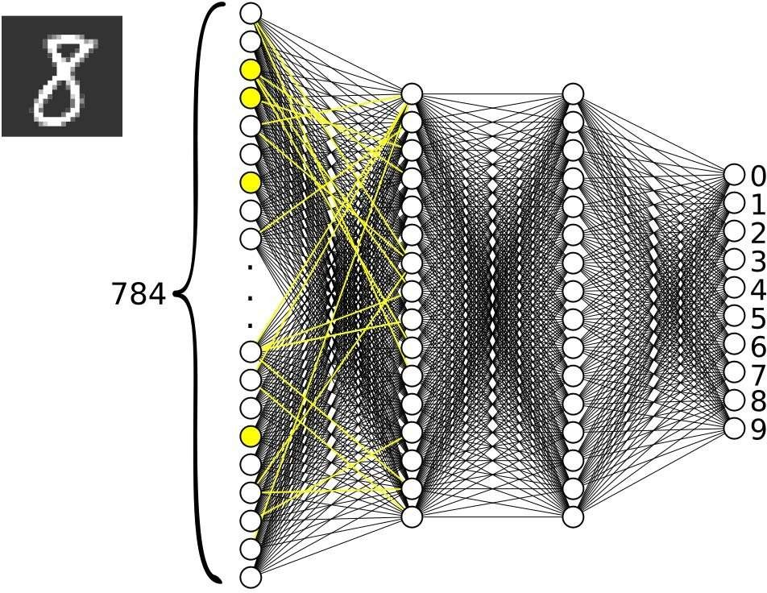
Flow of Data through the Network
This is how the data "flows" through the network and this is how the calculation process occurs.

Slide 17
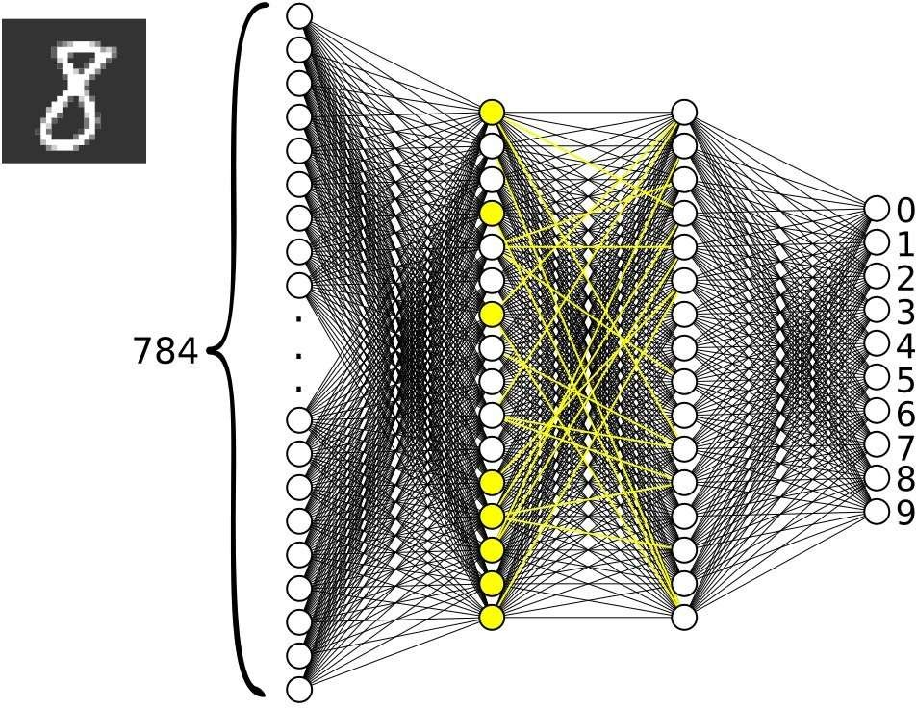
Flow of Data through the Network

Slide 18
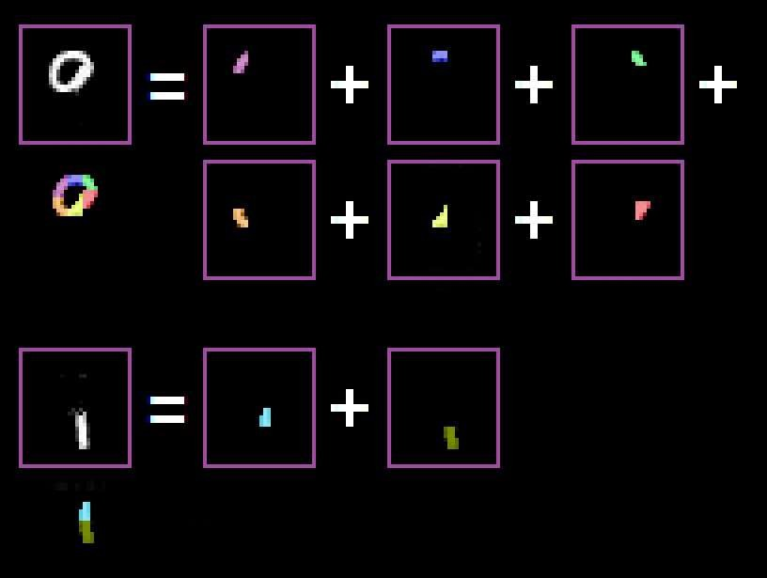
Composition
Now let's take a closer look at some characters. You can imagine them composed of smaller basic units.

Slide 19
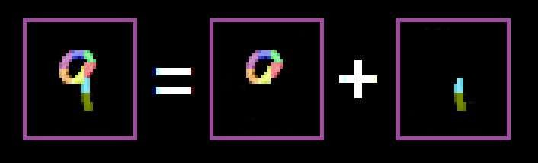
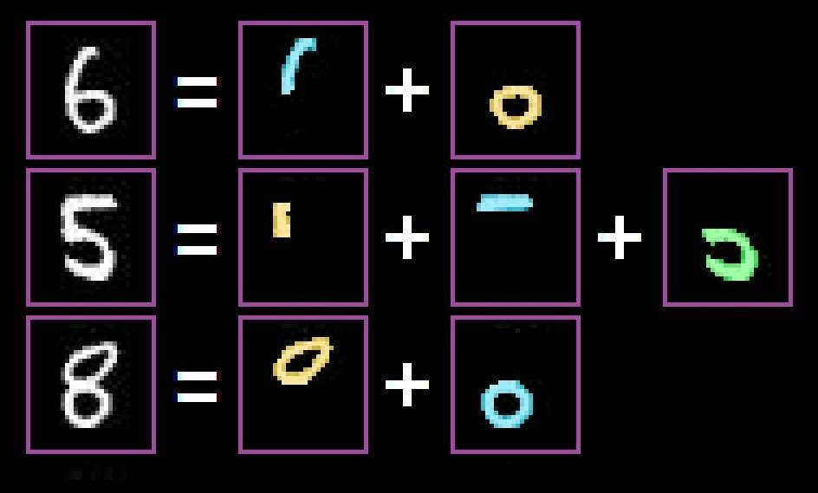
Composition
From these assembled units you can in turn assemble other larger units.
or:

Slide 20
Layer Structure and Processing Steps
One interpretation of the layered structure of a neural network is that different neurons specialize in different tasks and that the different levels correspond to different processing steps.
Neurons in layers further to the left would then search for simpler patterns, neurons in layers further to the right would search for more complicated patterns.

Slide 21
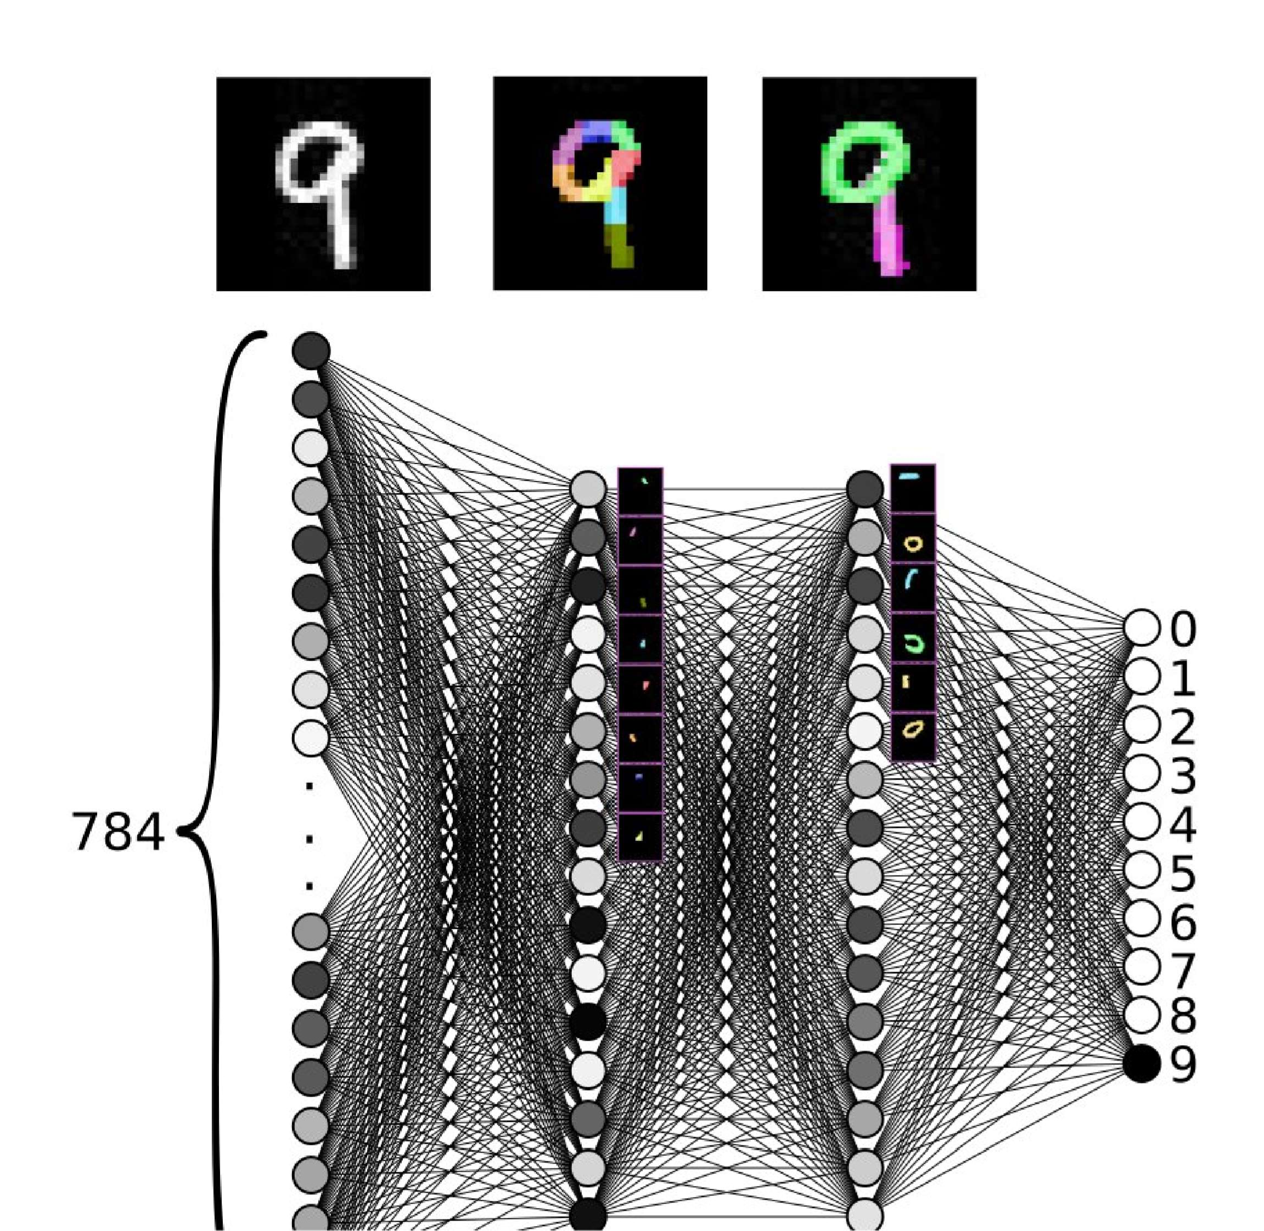

Slide 22
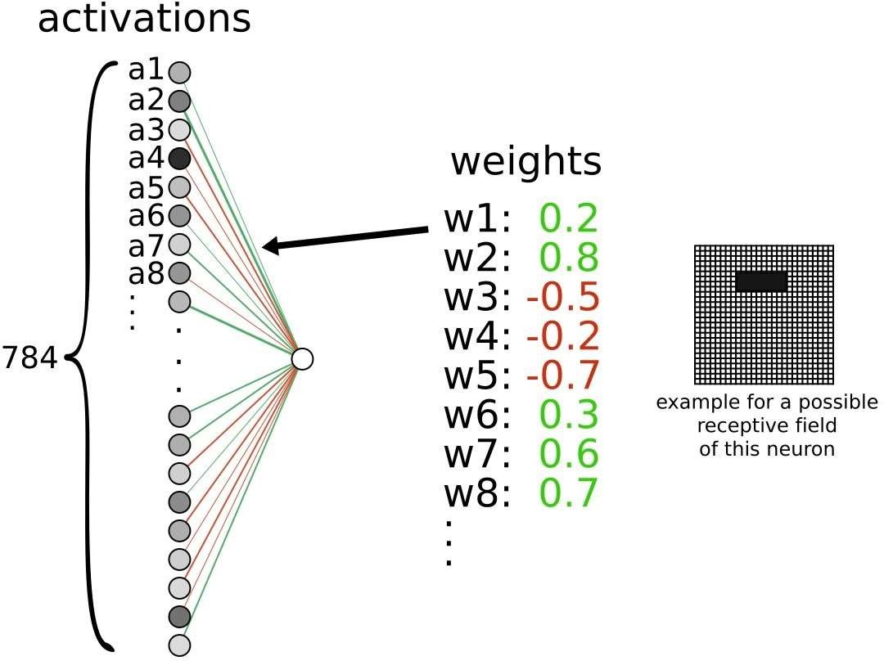
Implementation details
Each connection has a specific weight.

Slide 23
The neuron sums all incoming activations. The so-called "receptive field" is indicated on the right. This is the area of input neurons that relays information to a single downstream neuron. All weights that are not equal to 0 (or their amount is below some small chosen value) must therefore be taken into account. In our example, the receptive field of the neuron under consideration is still very large and may encompass the entire input area. In the course of the training (explained later), however, the neurons will each specialize in certain areas and the receptive field will shrink.
Receptive Field

Slide 24
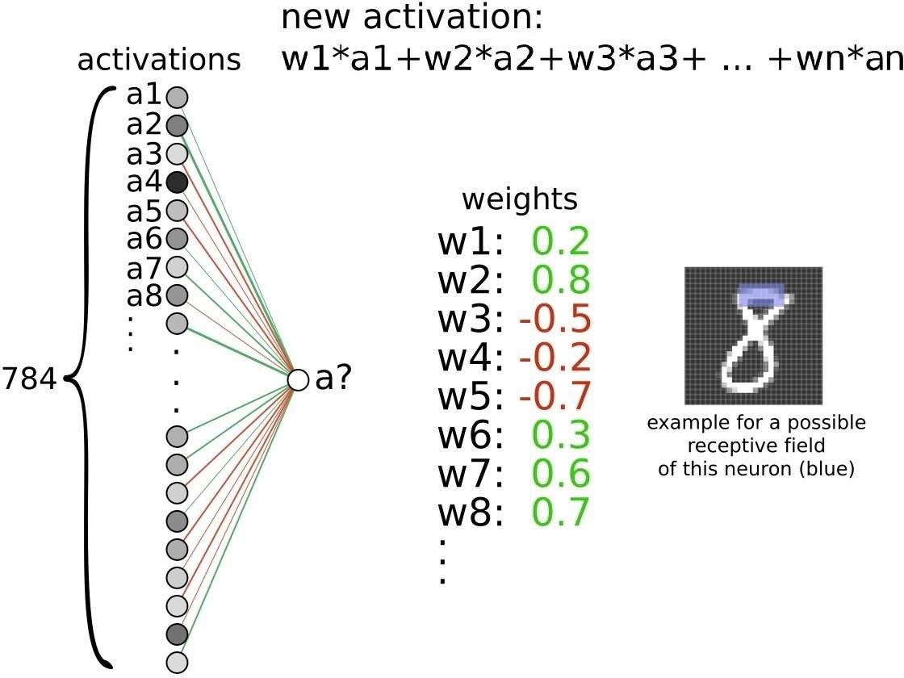
Receptive Field

Slide 25
Restrict()-Function
A multi-stage process with multiplications and sums takes place in the network. The values could easily (in a positive or negative direction) get out of hand (increase strongly). We will therefore use a function "restrict()" which ensures that the values are always restricted to the range between 0 and 1. Values that are already between 0 and 1 are hardly changed or not changed at all, values that are too large or too small are compressed so that they fall within the desired limits.

Slide 26
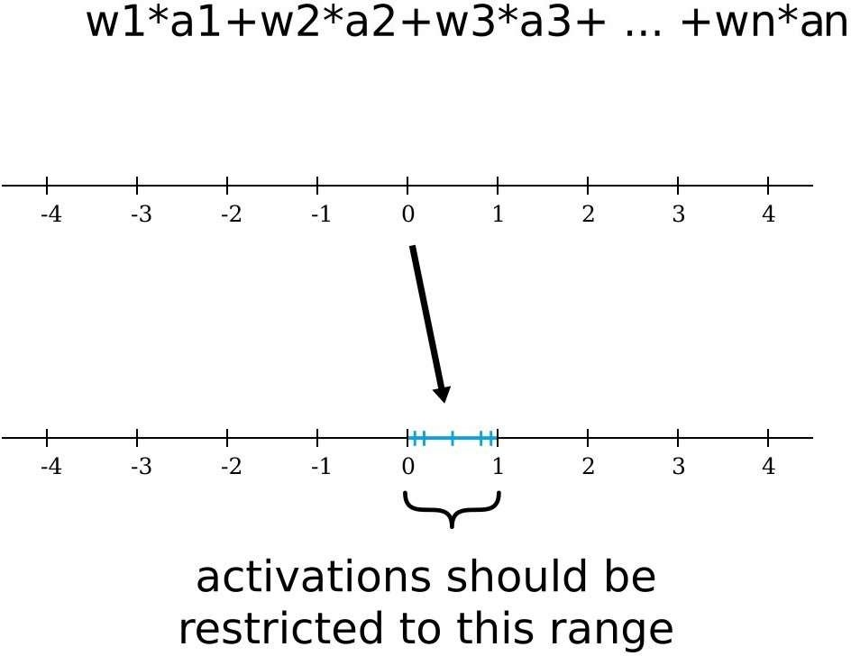
Restrict()-Function

Slide 27
Bias
We have one addition.
Neurons can have a certain bias.
This can manifest itself in a certain sluggishness of excitement (then more input is needed to activate the neuron) or in pre- excitation (then less input is needed to activate the neuron).

Slide 28
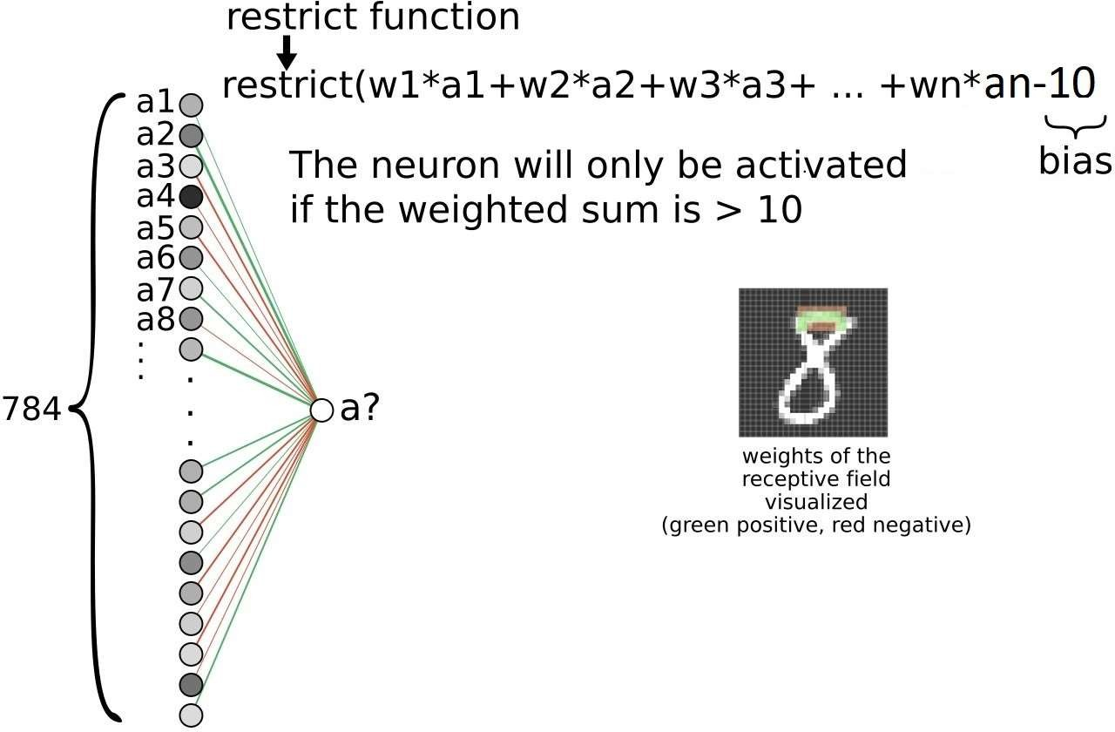
Bias

Slide 29
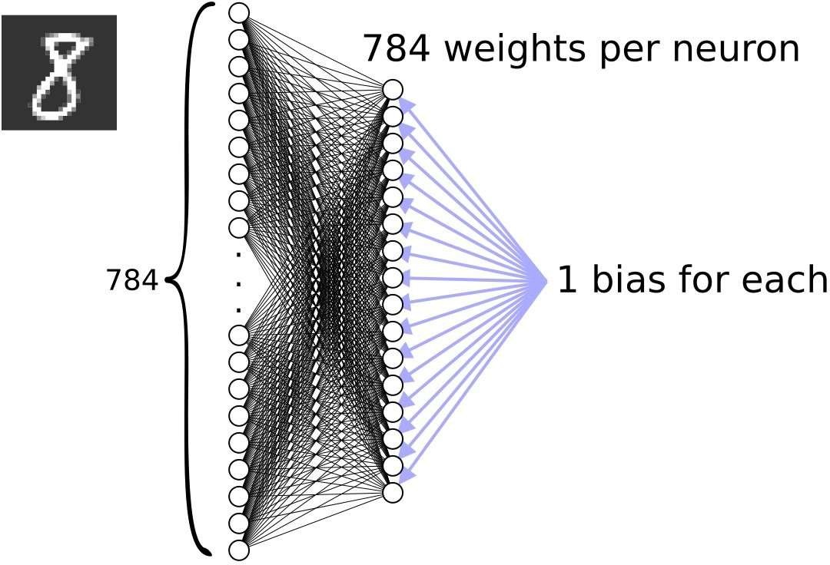
Bias

Slide 30
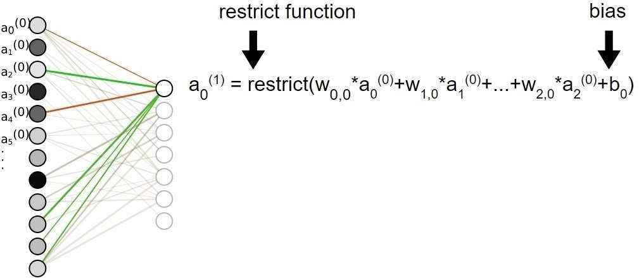
Complete Activation Function
Altogether one can write:

Slide 31
Exercises
Find the answers:
Where is the knowledge of a neural network stored?
What happens during the learning process?
How many degrees of freedom (these are all parameters that change during the process) does the neural network have?

Slide 32
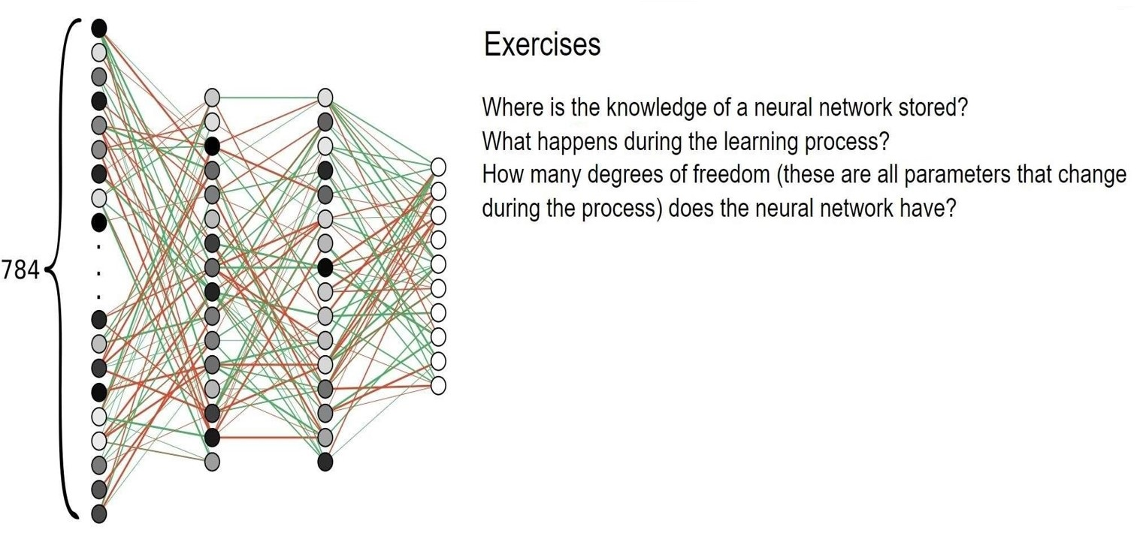

Slide 33
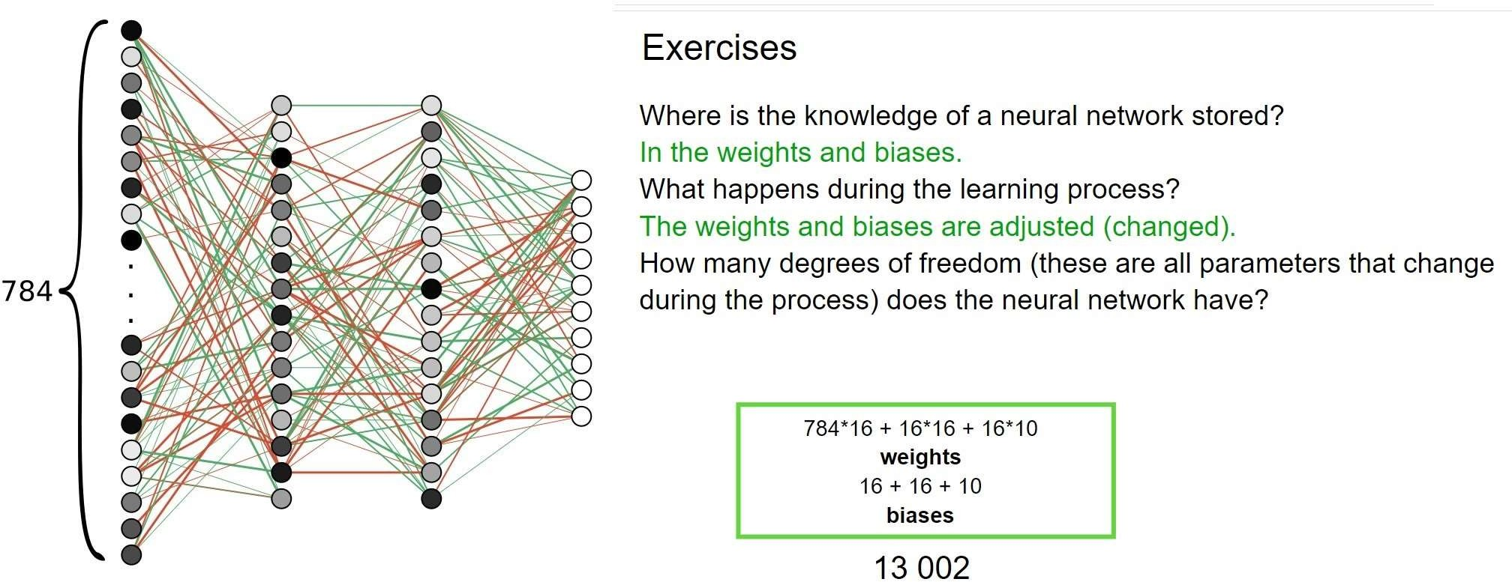

Slide 34
Network arrangements
Here we've looked at a fairly simple and widely used type of network, a feed-forward network.
There is a large and rapidly growing number of different network configurations (topologies) that are used for specific applications.

Slide 35
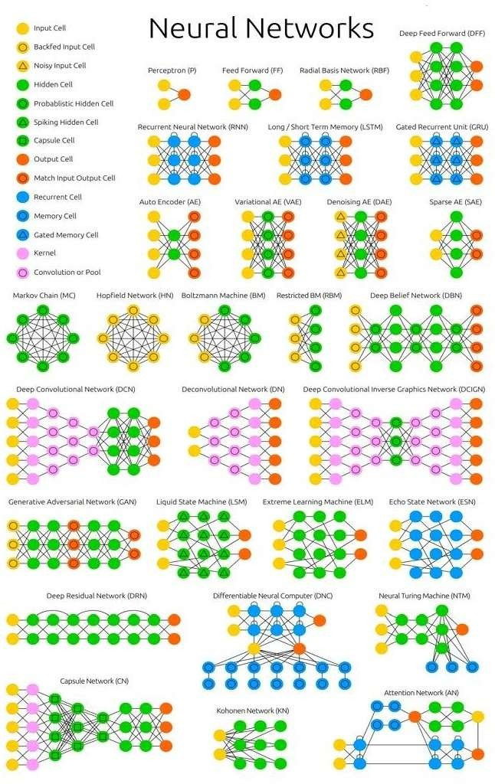
„Neural Network Zoo“
Stefan Leijnen and Fjodor van Veen
https://www.researchgate.net/publication/341373030_The_Neural_Network_Zoo/fulltext/5ebd3f60a6fdcc90d6752941/The Neural-Network-Zoo.pdf
(CC BY) license (http://creativecommons.org/licenses/by/4.0/)

Slide 36
Links
But what *is* a neural network? | Part 1, Deep Learning https://www.youtube.com/watch?v=aircAruvnKk

